Slide 2
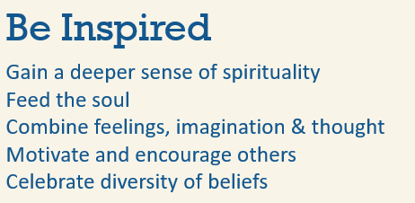
Notes:
Add a photo to this slide that represents Be Inspired

Slide 3
Notes:
Add a photo to this slide that represents Be Family

Slide 4
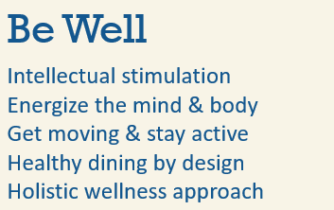
Notes:
Add a photo to this slide that represents Be Well

Slide 5
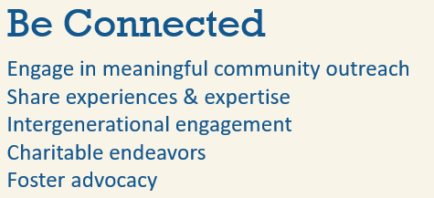
Notes:
Add a photo to this slide that represents Be Connected

Slide 6
Notes:
Add a photo to this slide that represents Be Adventurous

Slide 7
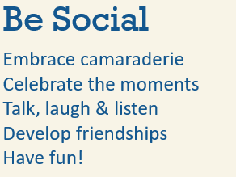
Notes:
Add a photo to this slide that represents Be Social

Slide 8
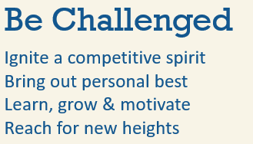
Notes:
Add a photo to this slide that represents Be Challenged

Slide 9
Notes:
Add any photos to this slide or delete the slide entirely

Slide 10
Notes:
Add any photos to this slide or delete the slide entirely

Slide 11
Notes:
Add any photos to this slide or delete the slide entirely

Slide 13
Notes:
Add the community logo to this slide.

