Slide 1
Social Media and Reputation Management

Slide 2
Overview
Starting in January 2023, MP&F will no longer be editing and posting daily Facebook content sent to the sslsocial@mpf.com inbox. Each community will be responsible for posting captions and photos, as well as monitoring their individual pages for comments and messages.
Our team will continue pre-scheduling relevant Facebook posts to all community pages and managing reviews on the page. The Executive Director, Director of Sales and Marketing, and the Vibrant Life® Director of each community are welcome and encouraged to post their own content throughout the month as well.
In this presentation, our team will go over tips, best practices and examples for Solstice Senior Living's Facebook pages.

Slide 3
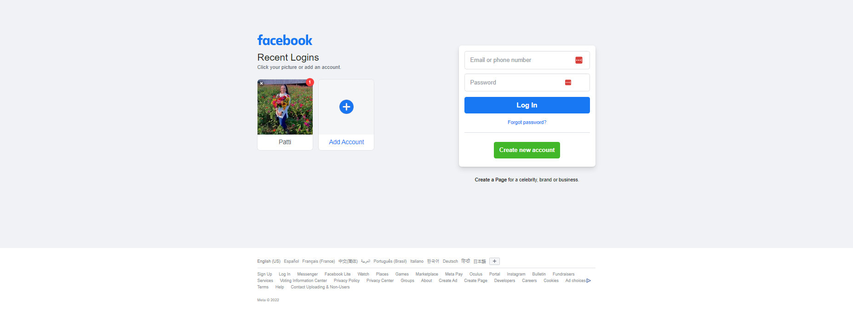
Accessing Your Facebook Page
1) Go to www.facebook.com and log in with your email and password.

Slide 4
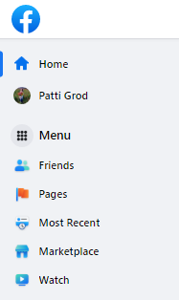
Accessing Your Facebook Page
2) To the left of your screen, click on the "🚩 Pages" icon.
Click this icon to access your Facebook page(s).

Slide 5
Accessing Your Facebook Page
3) Under "Pages You Manage," find your community's name and click on it.

Slide 6
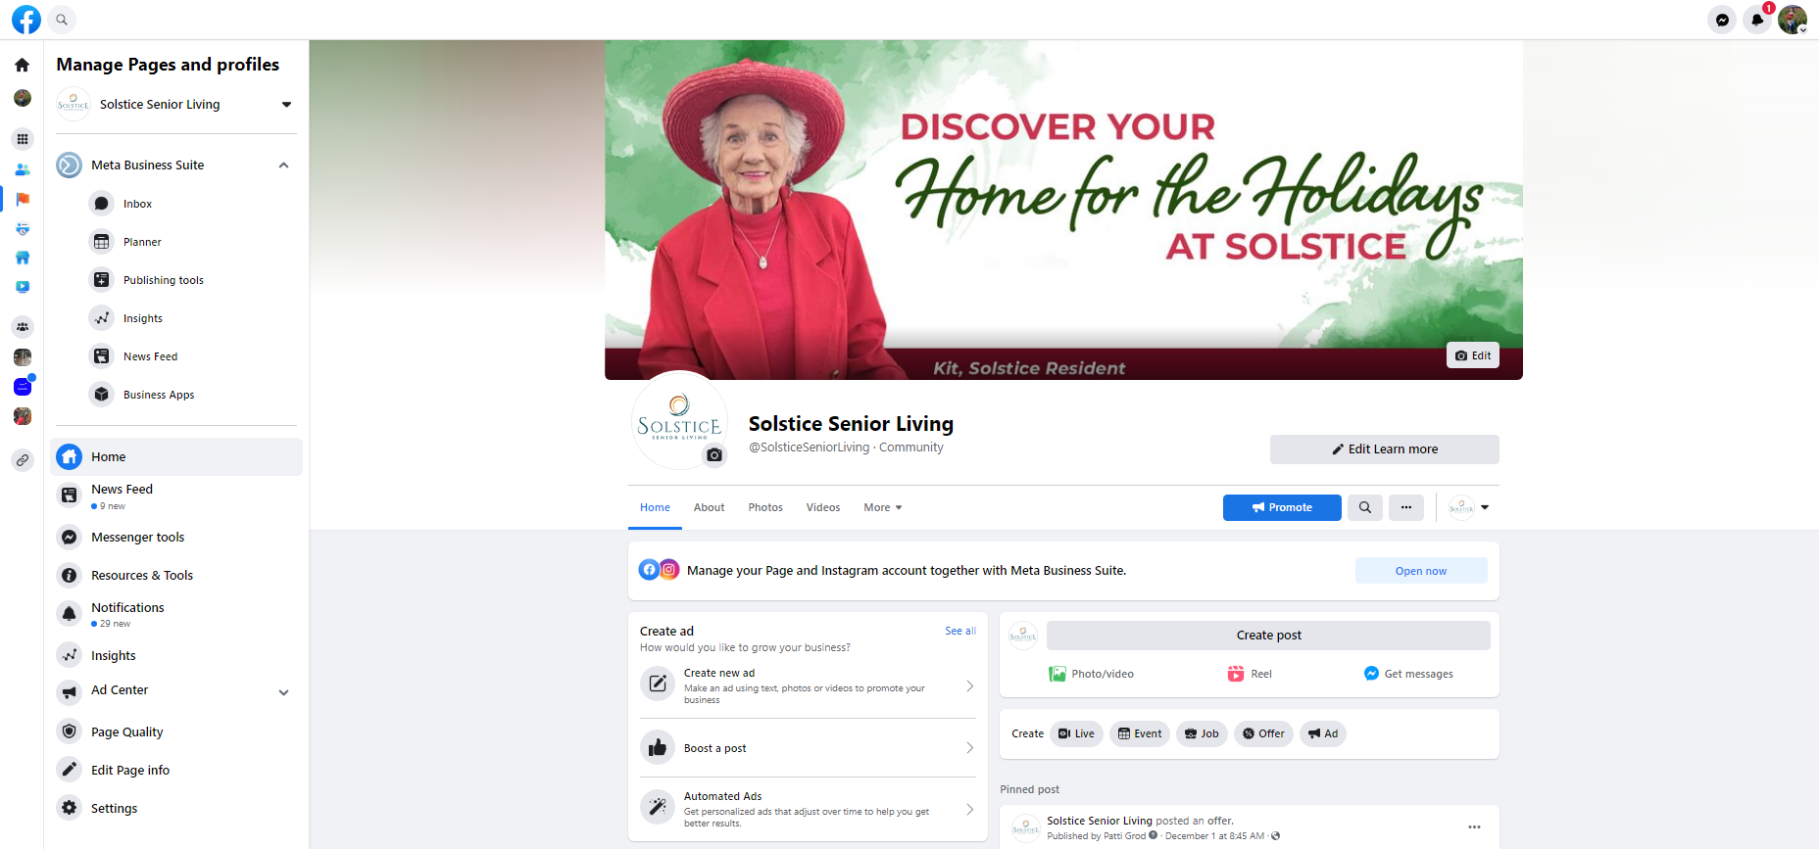
Accessing Your Facebook Page
4) You've made it to your community's Facebook page! Now you can create posts, check notifications and respond to messages.

Slide 7
Posting Content on Facebook
To post content, click on the "Create Post" button on your community's Facebook page.

Slide 8
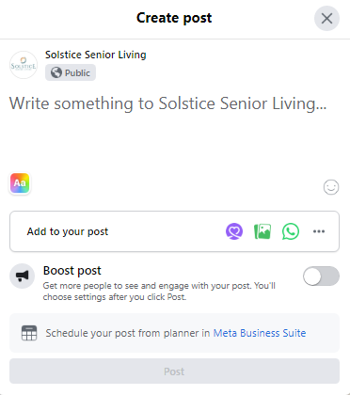
Posting Content on Facebook
Post caption goes here.
Add photos/videos by clicking on the green icon.
When you're done, click "Post"!

Slide 9
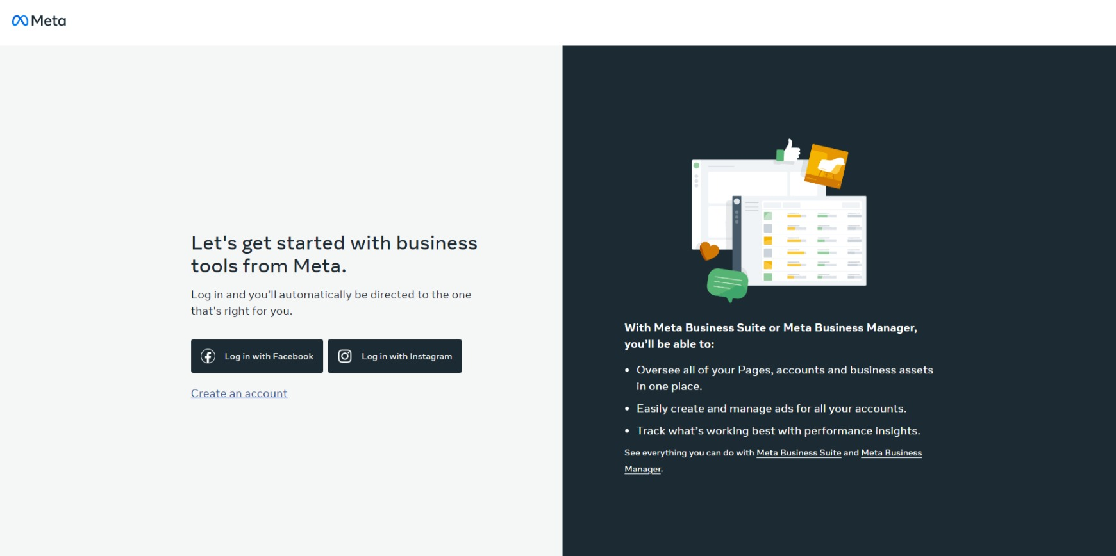
How to Get to Meta Business Suite
1) Go to business.facebook.com

Slide 10
How to Get to Meta Business Suite
2) Click "Log in with my Facebook."

Slide 11
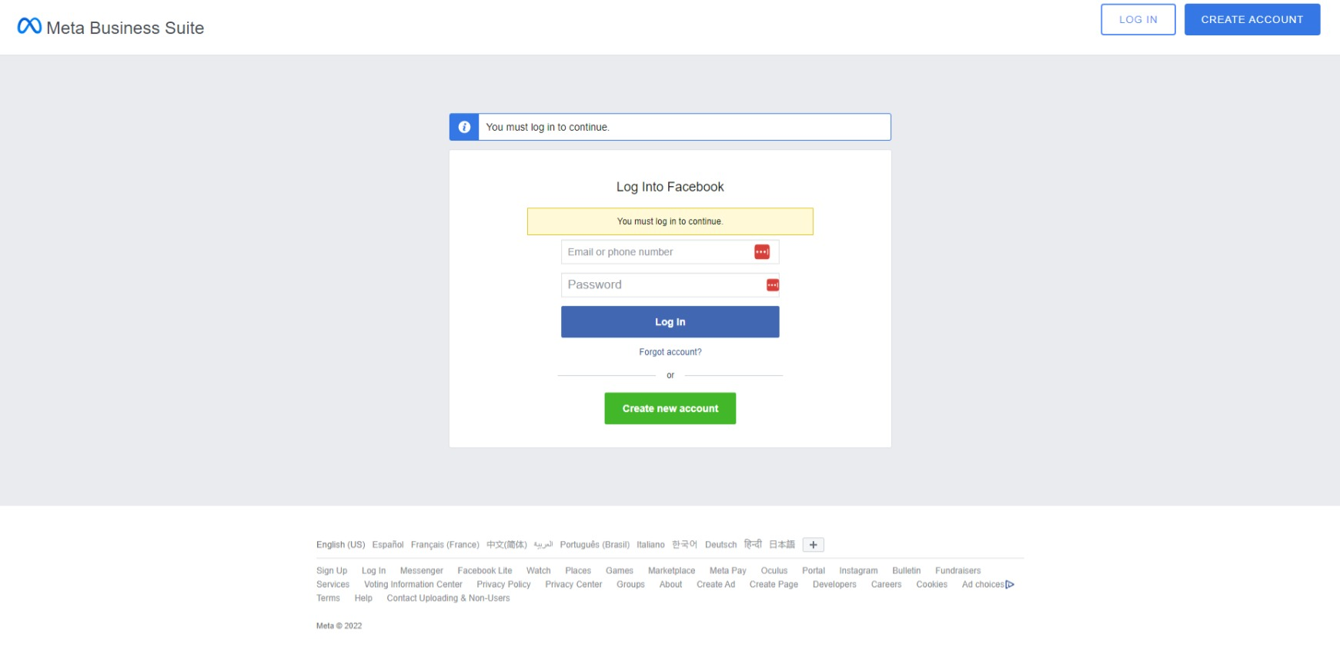
How to Get to Meta Business Suite
3) Enter your login credentials.

Slide 12
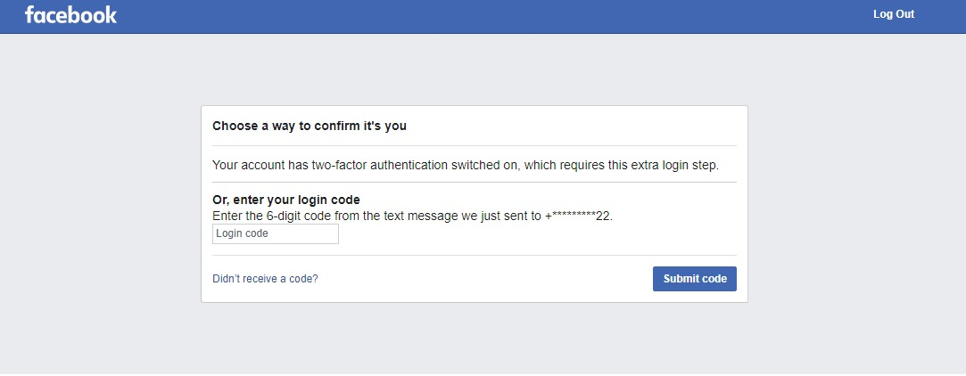
How to Get to Meta Business Suite
4) If your account has two-factor authentication, you will need to enter the code that was texted to you. If you did not receive a code, click on "Didn't receive a code."

Slide 13
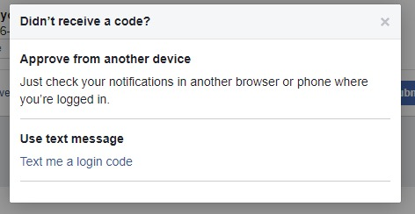
How to Get to Meta Business Suite
5) Then click on "Text me a login code."

Slide 14
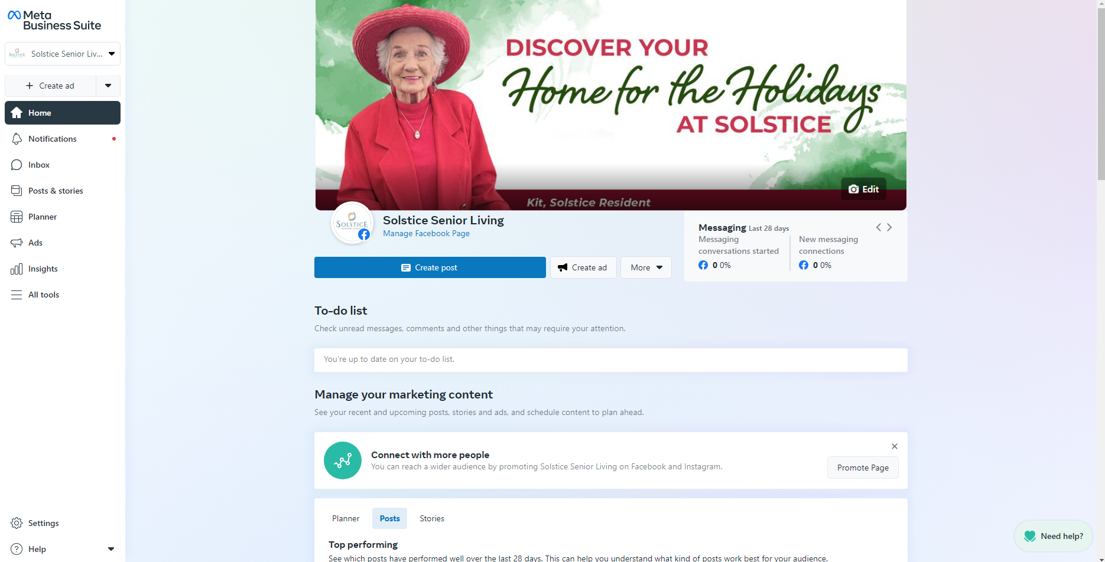
How to Get to Meta Business Suite

Slide 15
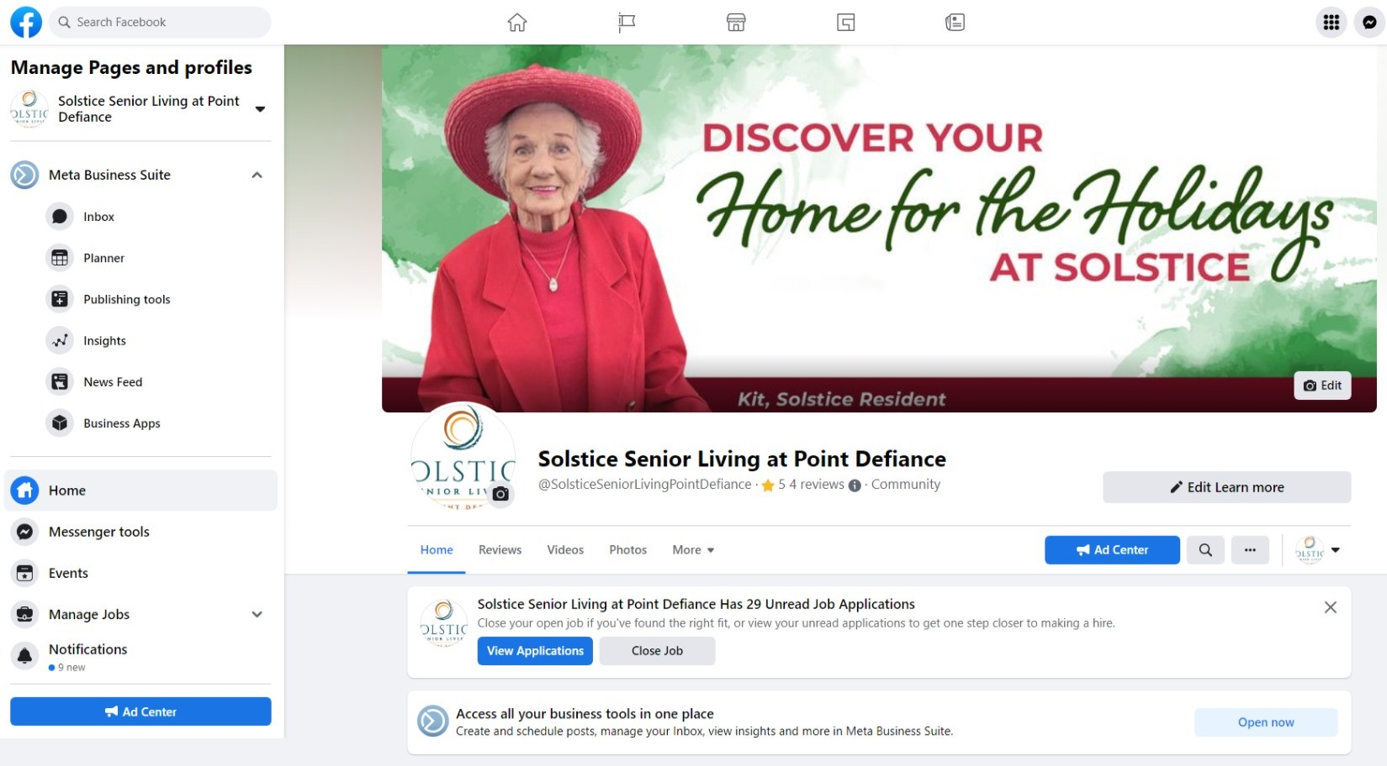
How to Get to Meta Business Suite (from your community Facebook page)
1) From your Facebook page, click on "Meta Business Suite" on the left side.

Slide 16
How to Get to Meta Business Suite (from your community Facebook page)
2) It will take you to your community's Meta Business Suite page (logo in upper left-hand corner), where you can post and schedule content, check notifications and messages, and more!

Slide 17
Scheduling Content (Meta Business Suite)
Meta Business Suite is a useful tool to schedule content on specific days and times. We recommend scheduling content to spread out your posts to increase post engagement (likes, comments, shares), give users a chance to react to one post at a time, and save you time from having to go back and post something manually later in the day!

Slide 18
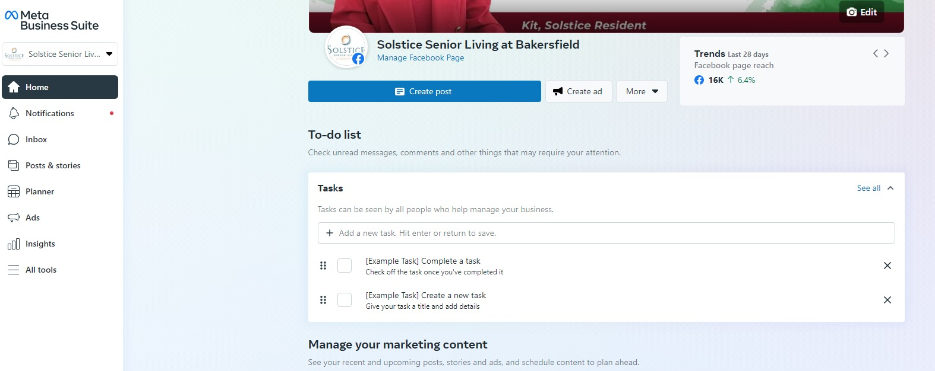
Scheduling Content (Meta Business Suite)
1) Once on your community's Meta Business Suite page, go to the menu of the left-hand side and select "Post and Stories."

Slide 19
Scheduling Content (Meta Business Suite)
2) Click "Create Post" in the upper right corner.

Slide 20
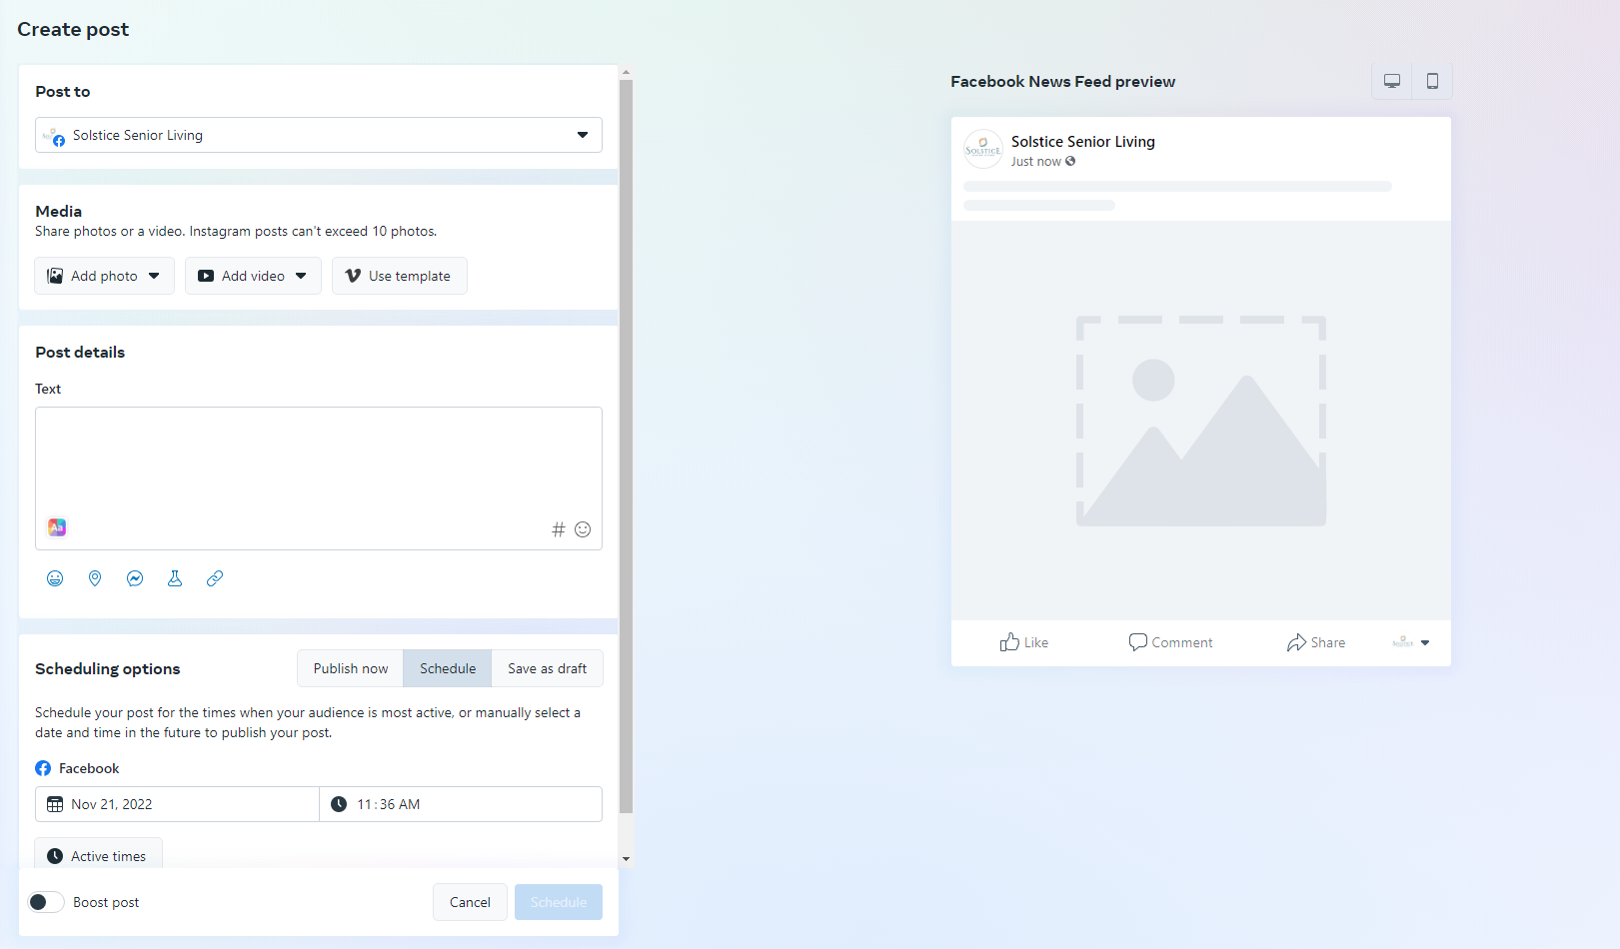
Scheduling Content (Meta Business Suite)
Add photos or videos
Caption
Adjust date/time to schedule content

Slide 21
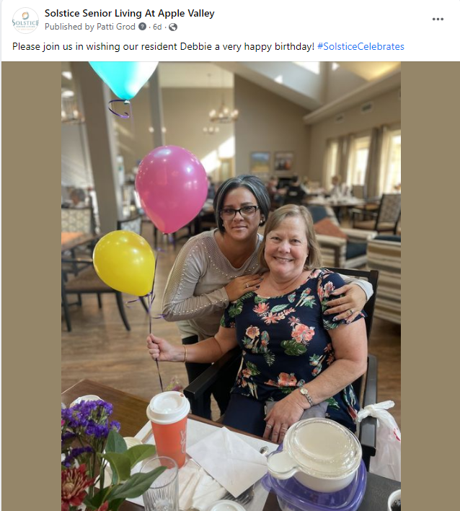
The Do's and Don'ts of Social Media (photos)
DO:
Post high-quality photos in .PNG or .JPEG form.
Choose the best five to 10 photos of your event per post. Quality over quantity!
If you have more than 10 high-quality photos you would like to post, consider making them into a Facebook Photo Album instead of a single post.
Show residents in their best light (clothes are adjusted, hair combed, area around them is free from clutter, not lying in bed, etc.).
Send great photos of residents to sslsocial@mpf.com to be used in future marketing and advertising efforts.
Know your audience! When taking photos and videos intended to be shared on Facebook, please know that more than just friends and family will see them.
Consider how a prospect may view your community or a family member may feel about the content.
If you want to post multiple things in one day, consider scheduling out content for different times to increase engagement. (Facebook Business Manager)
DON'T:
Post photos where some individuals are wearing masks and others are not or where masks are being worn incorrectly.
Solstice Senior Living at Apple Valley
Notes:
Sellars

Slide 22
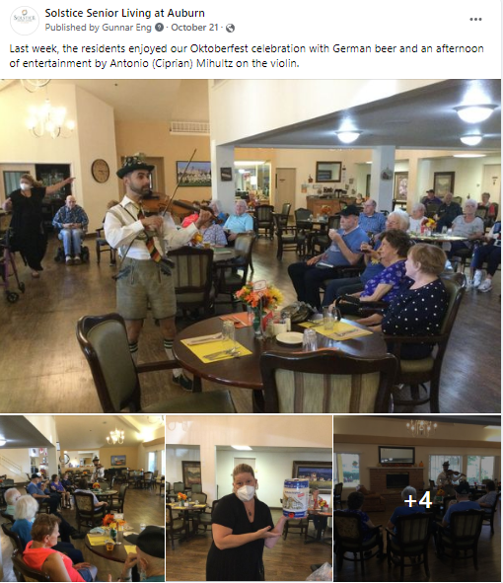
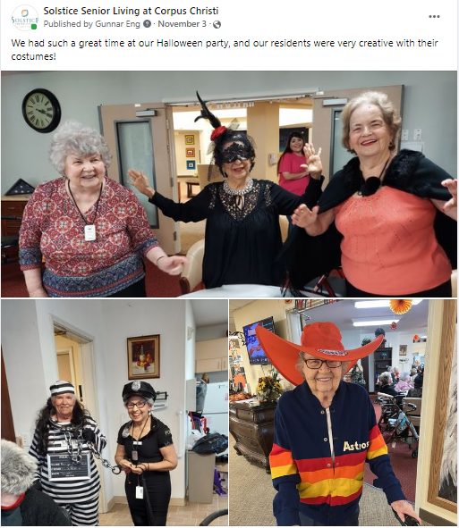
Examples
Solstice Senior Living at Auburn
Solstice Senior Living at Corpus Christi

Slide 23
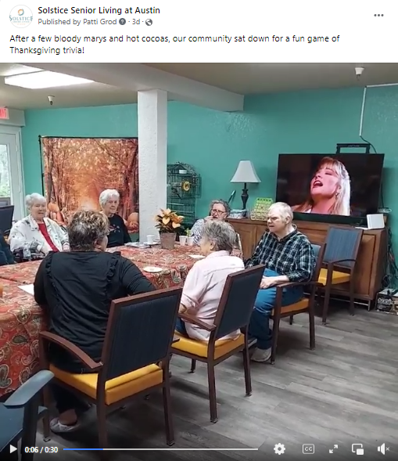
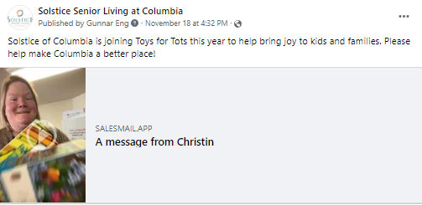
The Do's and Don'ts of Social Media (videos)
DO:
Post videos that show your community and residents in their best light.
Post videos separately from photos and photo albums.
When posting a SalesMail video, you can delete the link once it has auto-populated in the post.
Do ensure the music selection is clean and an appropriate version.
DON'T:
Play inappropriate or copyrighted music. Copyrighted music could cause your video to be taken down on the platform.
Disclose personal information about residents in videos.
Solstice Senior Living at Austin
Solstice Senior Living
at Columbia

Slide 24
The Do's and Don'ts of Social Media (captions)
DO:
Keep captions short and sweet.
Tag businesses, entertainers, locations, other Solstice communities and any other pages that might be relevant to your post.
Use spell check and read your caption before posting.
DON'T:
Use residents' full names. First name and last initial is ideal.

Slide 25
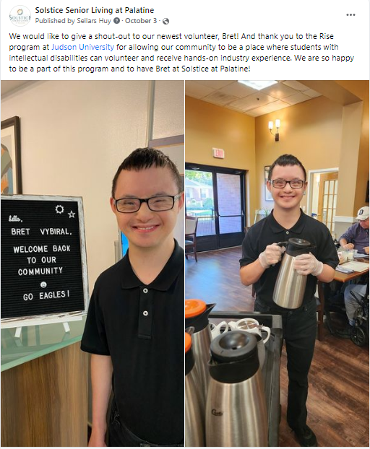
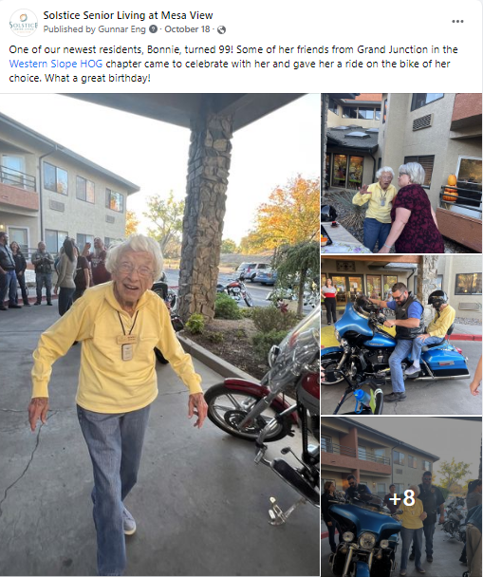
Examples
Solstice Senior Living at Palatine
Solstice Senior Living at Mesa View

Slide 26
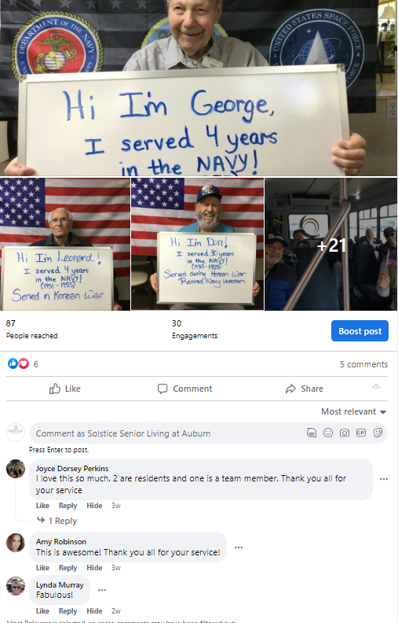
The Do's and Don'ts of Social Media (monitoring)
DO:
Monitor the comments and direct messages on your Facebook page every day and reply to them in a timely manner.
Hide unproductive negative comments. Hiding the comment is preferable to deleting the comment altogether because it's less likely the commenter will realize and continue complaining.
We don't necessarily recommend hiding every negative comment. If someone has a valid concern, it can be worthwhile to respond and try to take it offline by asking the user to call or email your community.
Reply to serious inquiries and offer your community phone number for prospects and family members to reach out.
DON'T:
Use a resident's full name when corresponding via comments or direct message.
Solstice Senior Living at Auburn

Slide 27
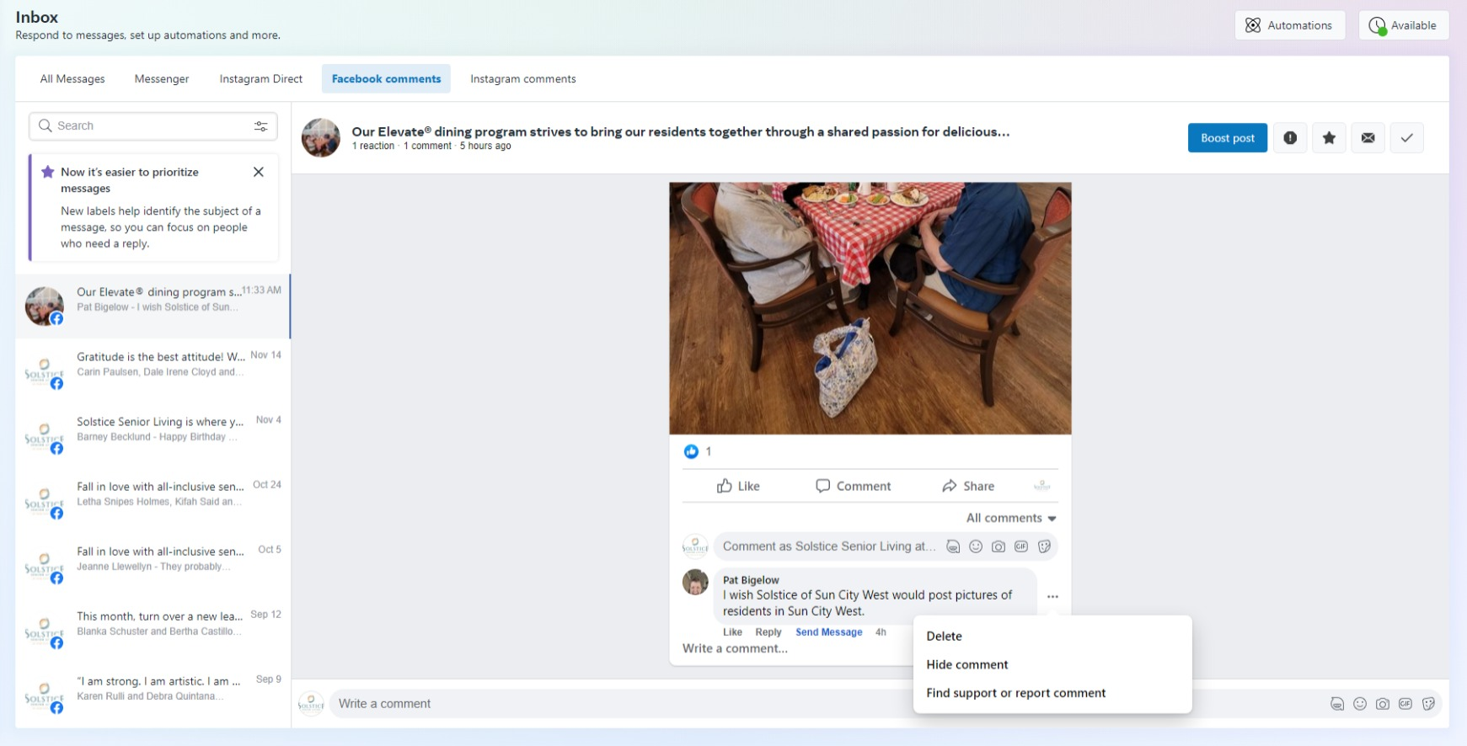
Example
Switch to "All comments"
Click on the three dots to bring up the "Hide comment" option

Slide 28
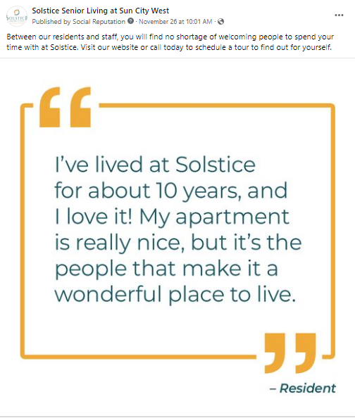
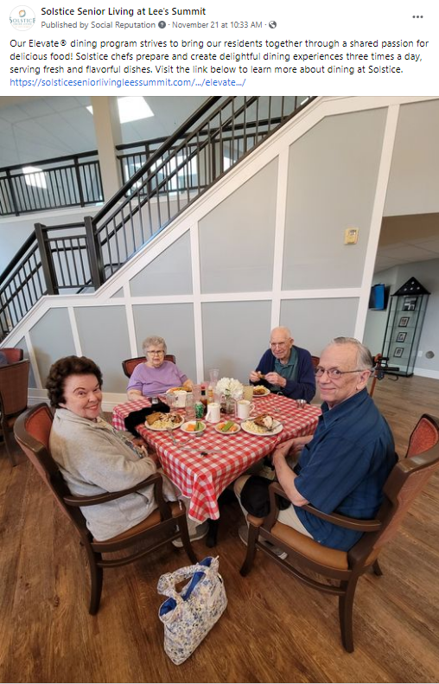
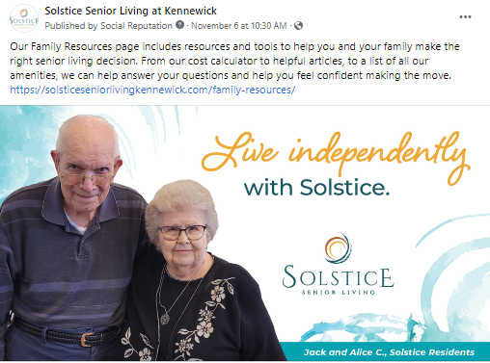
Examples of MP&F Content

Slide 29
Questions & Answers

